Slide 1
Using Natural Language Processing to predict suicidal ideation on Reddit
Author: Eugene Baraka

Slide 2
Outline
Background and Current Research
Methods
Results
Discussion
Conclusion AND LIMIATIONS

Slide 3

Background and current research

Slide 4
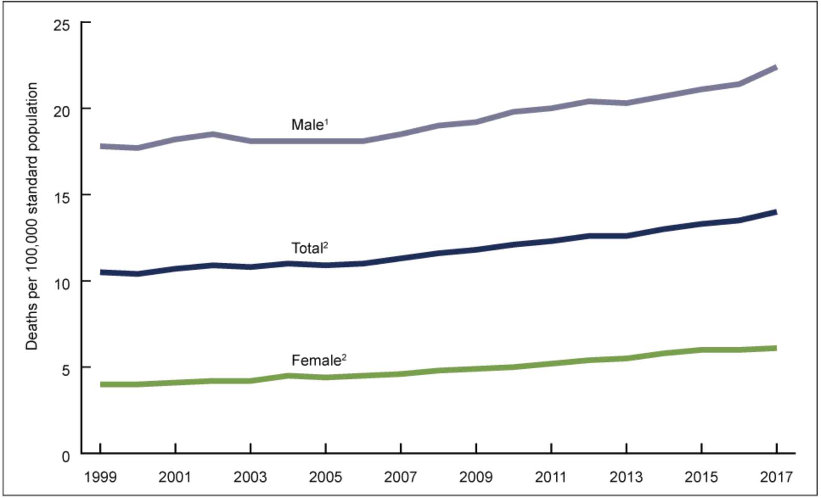
BACKGROUND
Age-adjusted suicide rates by sex in the US, 1999-2017³
Suicide is one of the leading causes of death globally¹
An estimated 800,000 deaths annually → One death every 40 seconds
Among the youth, suicide is the second most common cause of death in the US²
The age-adjusted suicide rates have significantly increased over the past decade, worldwide²
Research suggests that self-harming youth are more active on social networks than the non-self-harming youth²
Significant increasing trend from 2006 through 2017
Increasing trend from 1999 through 2017
¹WHO 2014
²Memon et al. 2018
³NCH 2018

Slide 5
CAN MACHINE LEARNING HELP?
Active area of research in machine learning and medicine
Over 100 papers published on PubMed in the past decade
Multiple studies^{4,5,6} explored the use of ML for early detection of suicidal thoughts and the progress has been impressive
Overarching hypothesis: early suicide detection saves lives
Primary aim: use state-of-the-art ML techniques to classify suicidal and non-suicidal thoughts
⁴Jashinsky et al. 2014
⁵Ueda et al. 2014
⁶Morese et al. 2022

Slide 6

methods

Slide 7

About the data
Collected from Reddit platform, which leverages group chats known as sub-reddits
Each subreddit allocated to a specific topic and individuals interested in the topic join the group to participate in discussions
The data collected using PushShift API from
"SuicideWatch" made of over 390k users (October 2022) → labelled as suicidal
"Teenagers" made of contains 2.9 million users (October 2022) → labelled as non-suicidal
Data publicly available on Kaggle⁷
⁷Muhammad 2022

Slide 8
Data cleaning and Preprocessing
Dataset made of 232,074 unique posts posted between December 16, 2008 to January 1, 2021
Each post classified as either suicidal or non suicidal
No missing values and both classes were balanced (50%-50%)
Contrations were expanded in each post (e.g., I’m → I am)
Text cleaning involved removing:
Punctuations (e.g., quotations, question marks) and URLs
Stop words (e.g., I, to)
Changed all text to lower case

Slide 9
Data cleaning and Preprocessing (Cont’d…)
More features were extracted from original text
Number of words, characters, and sentences
Average word and sentence lengths
Sentiment analysis per post
Compare the extracted features between the two classes during Exploratory Data Analysis

Slide 10
Modelling
Classification problem (either suicidal or not)
Multiple classification models explored to choose the top performing models to fine tune
Logistic Regression
K-Nearest Neighbor (KNN)
Decision Trees
XGBoost
Random Forest
Support Vector Machines (SVM)
Models compared to choose top 3 performing models
Precision, Recall, and F-1 score were the metrics used
Hyperparameter optimization using GridSearch for the models to choose the best model
Transfer learning using DistillBert was performed to compare its performance with the best model

Slide 11

RESULTS

Slide 12
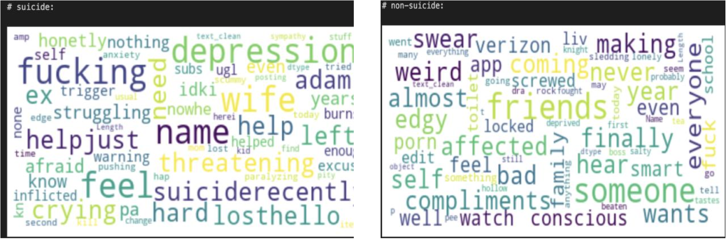
COMPARISON BETWEEN CLASSES
The most common words by post category (left: suicidal, right: non-suicidal)
Suicidal posts generally contain more negative words than non-suicidal text
Suicidal posts involved discussions about struggling (e.g., breakups, suicide, depression, crying, being lost)
Non-suicidal posts included conversations around daily life (e.g., school, compliments, movies, family and friends, food)

Slide 13
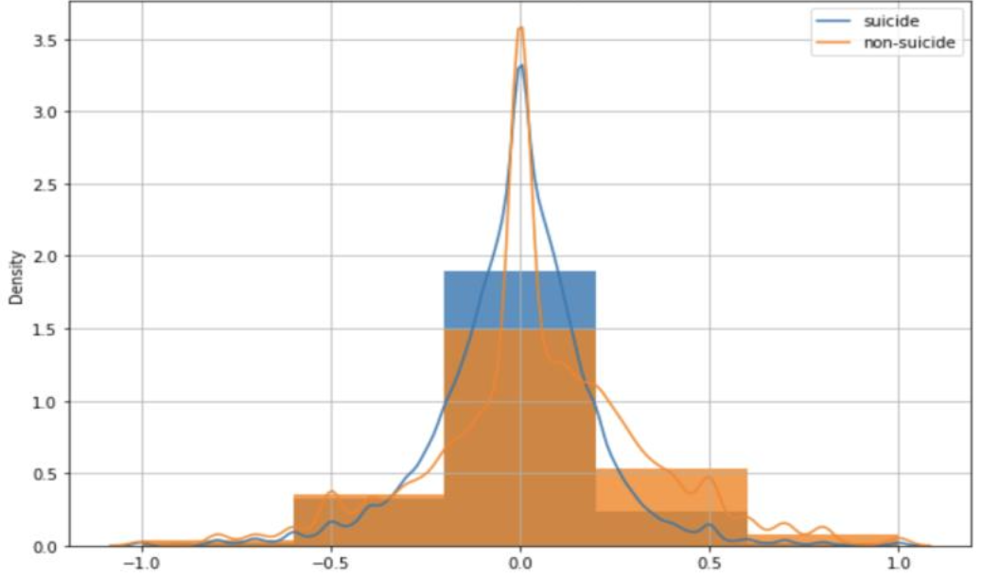
COMPARISON BETWEEN CLASSES (Cont’d…)
Sentiment analysis by post class
No difference in number of words, characters, or sentences used between the two groups
No difference in the average post length
Sentiment curves overlap suggesting no difference in sentiments between the two classes

Slide 14
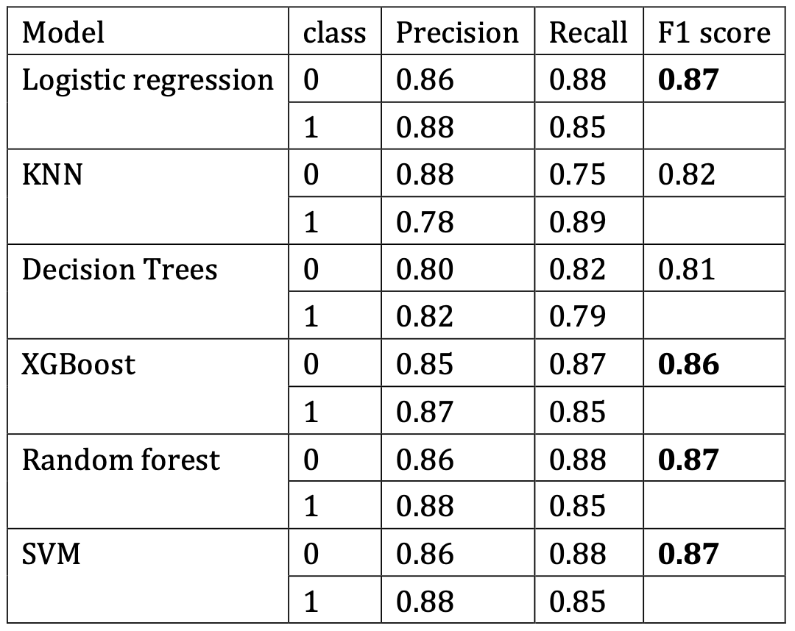
MODEL RESULTS
Results of preliminary non-tuned models
Logistic Regression, Random Forest, SVM had the highest F1 score (87%) followed by XGBoost (86%)
Explored further through hyperparameter optimization to choose the best-performing model
After tunning, Logistic Regression had the highest F1 score of 90%

Slide 15
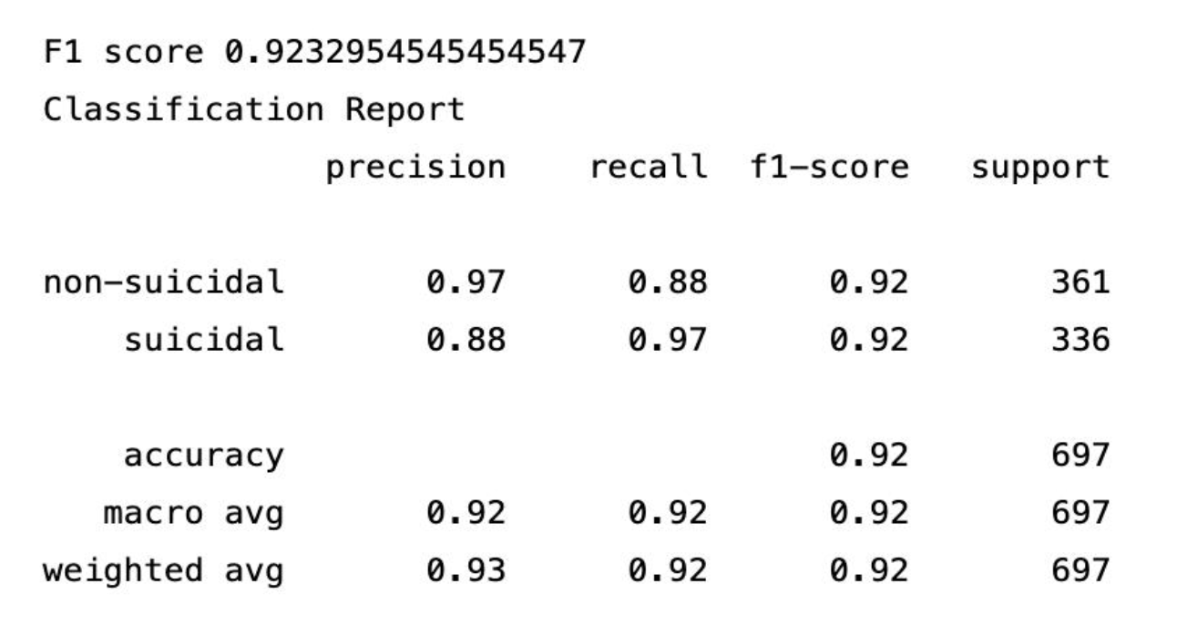
DISTILLBERT
Text cleaned using DistillBERT’s cleaning and preprocessing modules
Model trained on 5 total epochs with 2 input layers
Number of epochs and layers reduced due to small computation power
F1 score of 92.3%
Results of DistillBERT classification model

Slide 16

DISCUSSION

Slide 17
Discussion
The best models were Logistic Regression (90% F1 score) and DistillBERT model (92.3% F1 score)
Adding more epochs and input layers would significantly improve model performance
However, results from Neural Networks lack interpretability. If interested in which words are more likely to be associated with suicidal thoughts, a logistic regression would be better suited
It is possible to predict suicidal thoughts and the accuracy can be high with modern NLP techniques, as also found by previous studies^{4,5,6}
However, multiple challenges remain
⁴Jashinsky et al. 2014
⁵Ueda et al. 2014
⁶Morese et al. 2022

Slide 18

LIMITATIONS
Low data quality, associated with labelling costs
Lack of reliable publicly available datasets → privacy concerns, among others
This analysis assumed data from SuicideWatch are automatically suicidal and vice versa for Teenagers subreddit
There is a thin line between anxiety, depression, and suicidal thoughts
Need medical experts to label the data for more accurate predictions
Post from SuicideWatch. Is this a suidal thought, depression, anxiety?

Slide 19

THANK YOU

